Slide 1
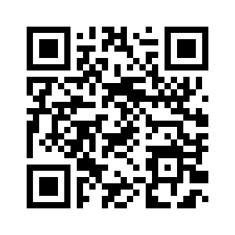
Right-click here, choose Change Picture, and upload your own QR code.
pds-geosciences.wustl.edu
Replace this URL with the one your QR code goes to.

